Slide 1
Pandas

Slide 2
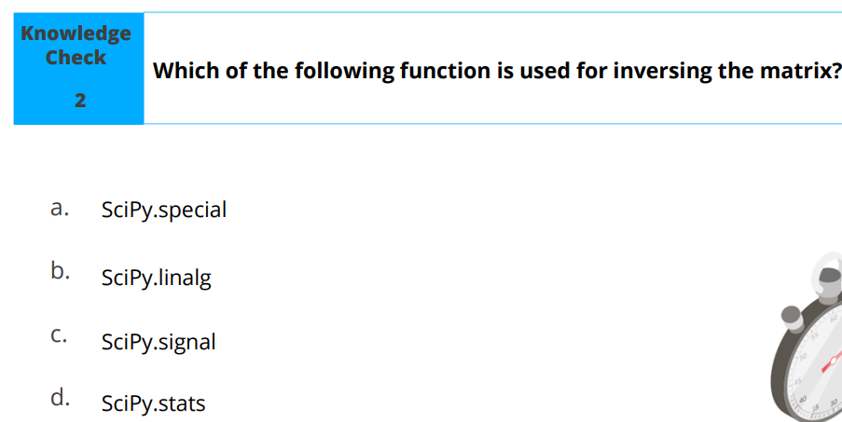

Slide 3
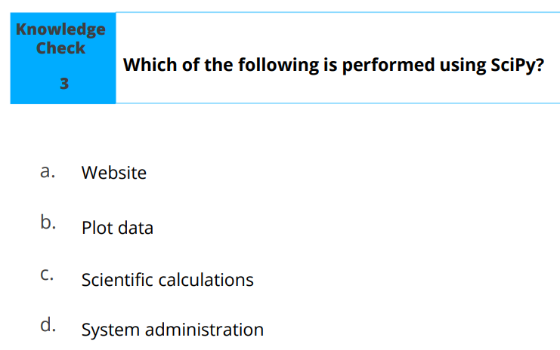

Slide 4
Learning Objectives
By the end of this lesson, you will be able to:
Explain Pandas and its features
List different data structures of Pandas
Outline the process to create series and DataFrame with data inputs
Explain how to view, select, and access elements in a data structure
Describe the procedure to handle vectorized operations
Illustrate how to handle missing values
Analyze data with different data operation methods

Slide 5
Introduction to Pandas
The advent of Pandas is not to underrate the efficacy of computing in numpy but to give more features such as:
Powerful data structure
High performance merging and joining of data sets
Tools for reading and writing data
Intelligent and automated data alignment
Easy data aggregation and transformation
Fast and efficient data wrangling

Slide 6
Data Structures
Data structures in pandas are basic building blocks that helps data scientist in wrangling and analyzing data
The four main libraries of Pandas data structure are:
Series
Data Frame
Panel
Panel 4D
In this lesson, our emphasis will be on Series and Data Frame since those are the two major data structures data scientist use in tackling real world problems

Slide 7
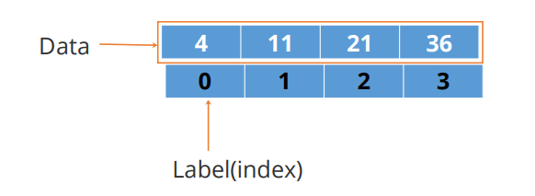
Data Structures : Series
Series is a one-dimensional array-like object containing data and labels (or index).
Data alignment is intrinsic and will not be broken until changed explicitly by program

Slide 8
Series can be created with different data inputs such as:
• ndarray
• dict
• scalar
• list

Slide 9
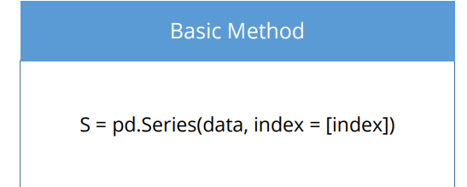
How to create a Series
Key points to note while creating a series are:
Import Pandas as it is the main library (Import pandas as pd)
Import NumPy while working with ndarrays (Import numpy as np)
Apply the syntax and pass the data elements as arguments

Slide 10
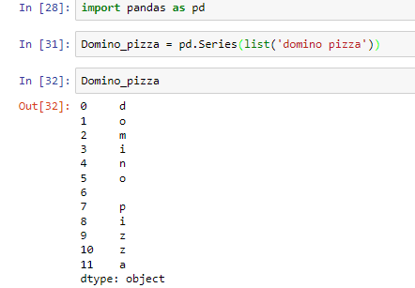

Slide 11
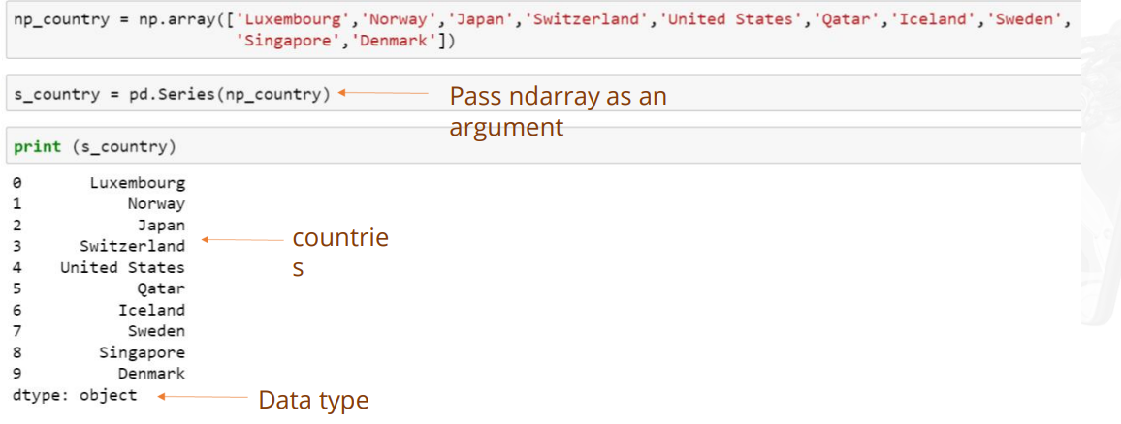
Creating Series from an ndarray

Slide 12
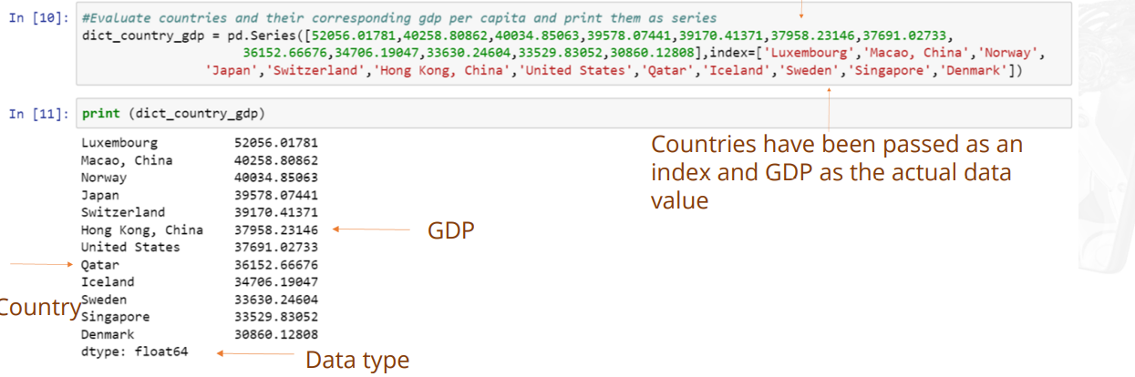
Creating series from a list

Slide 13
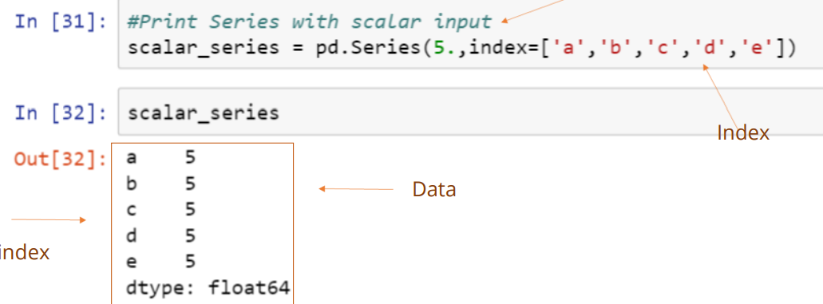
Creating Series from Scalar

Slide 14
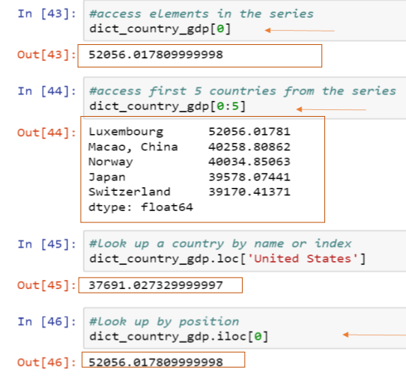
Accessing Elements in Series
Data can be accessed through different functions like loc, iloc by passing data element position or index range.

Slide 15
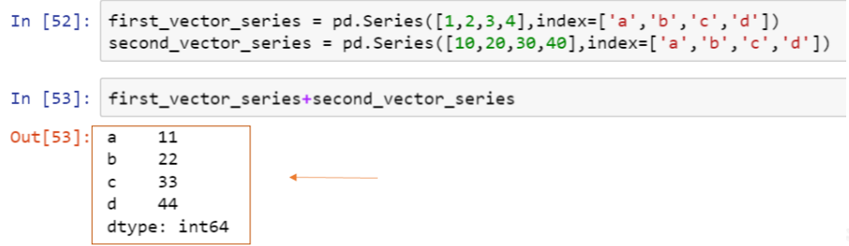
Vectorizing Operations in Series
Vectorized operations are performed by the data element’s position.

Slide 16
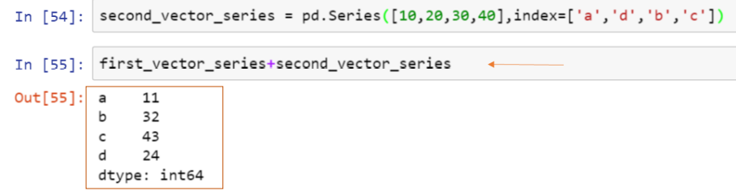
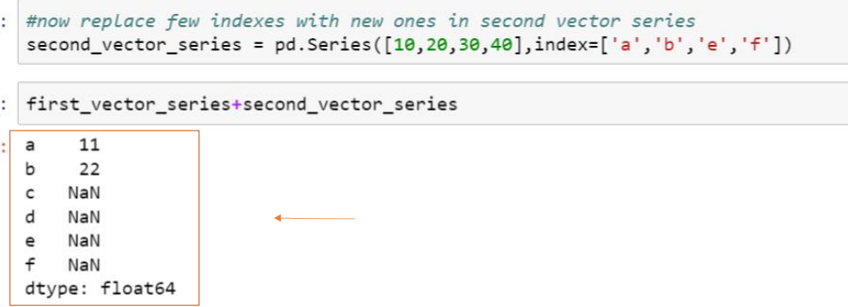

Slide 17
DataFrames
DataFrame is a two-dimensional labeled data structure with columns of potentially different types.
Data Input in DataFrame includes:
• ndarray
• dict
• List
• Series
• DataFrame

Slide 18
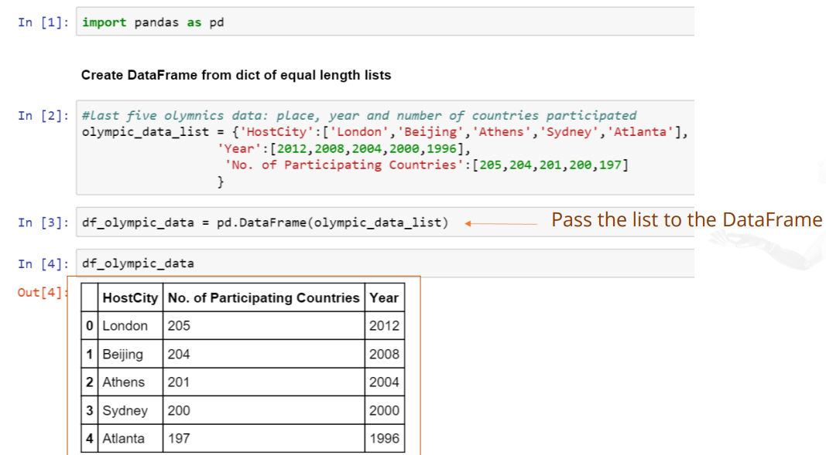
Creating DataFrame from Lists

Slide 19
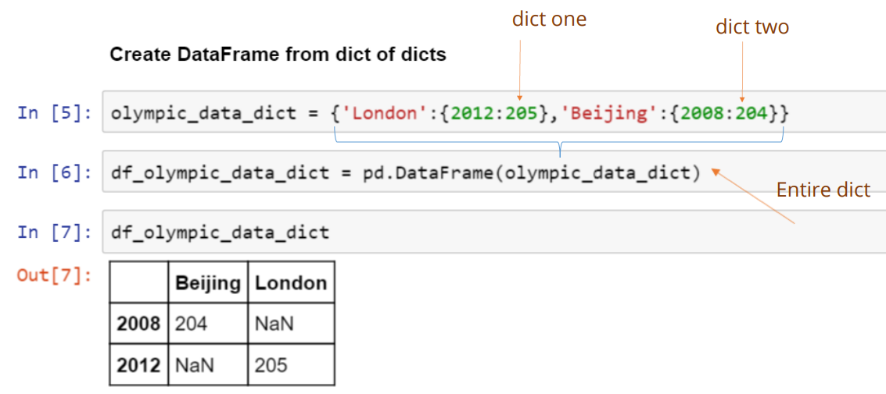
Creating DataFrame from dict

Slide 20
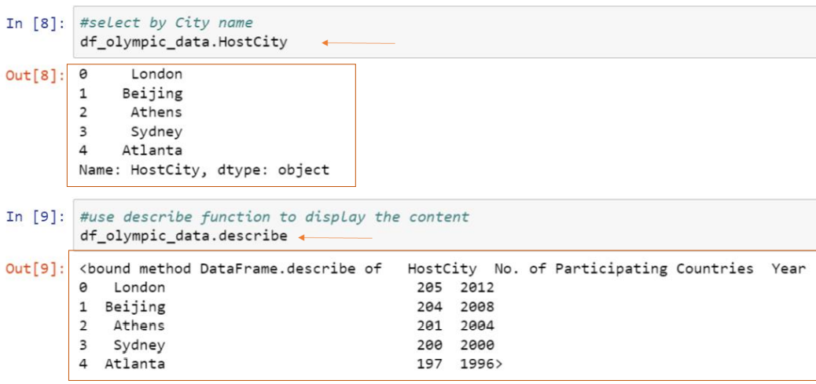
Viewing DataFrame
You can view a DataFrame by referring to the column name or with the describe function.

Slide 21
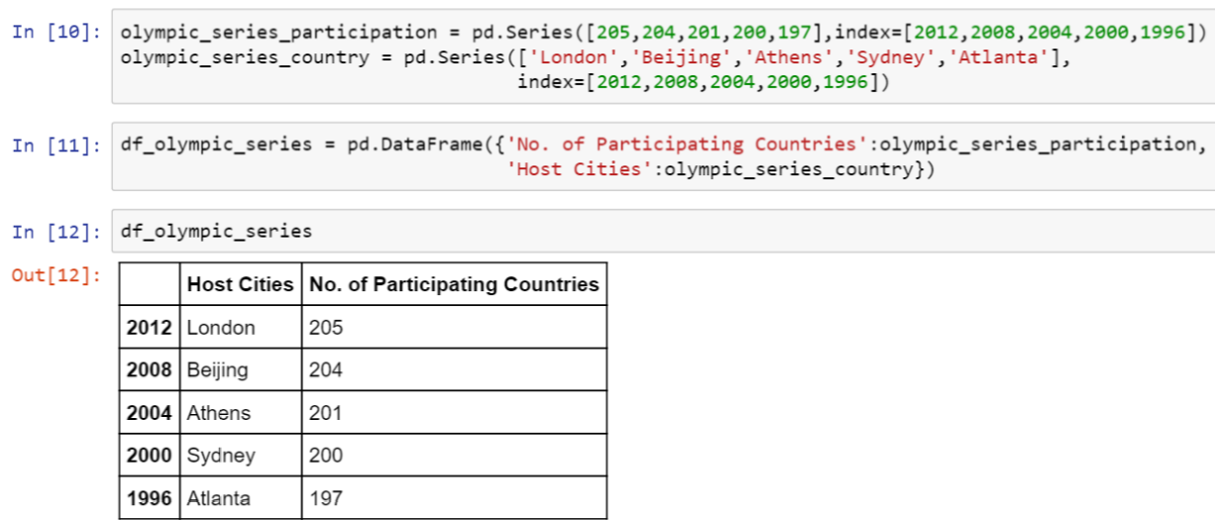
Creating DataFrame from dict of Series

Slide 22
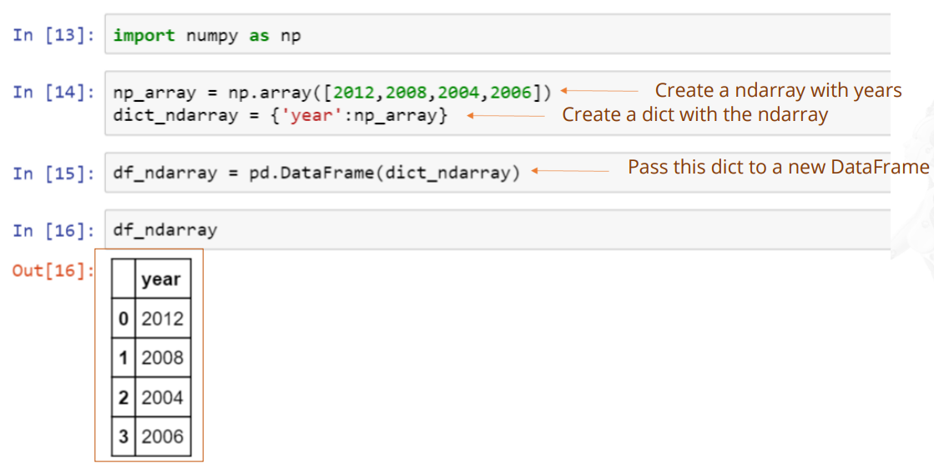
Creating DataFrame from ndarray

Slide 23
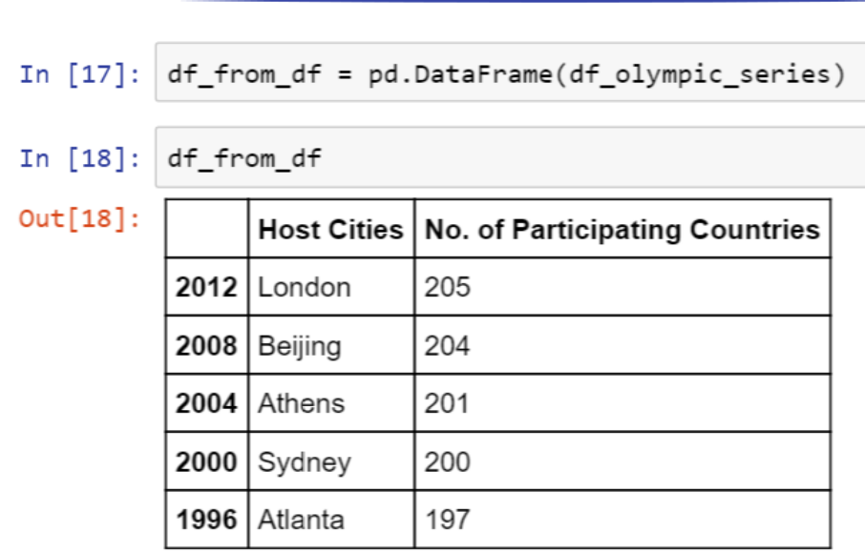
Creating DataFrame from DataFrame Object

Slide 24
Missing Values
Below are some of the factors that might lead to missing data values:
Software issue
Data integration issue
Network issue
Data not provided by the source

Slide 25
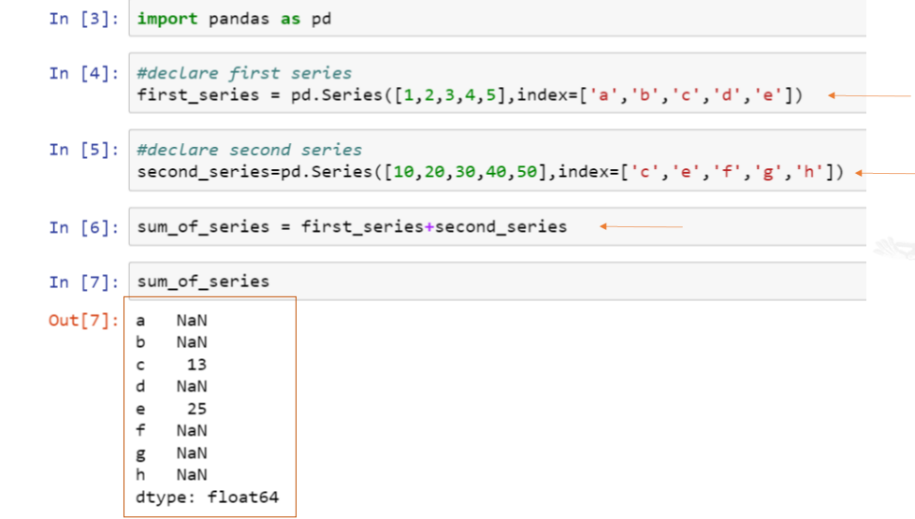

Slide 26
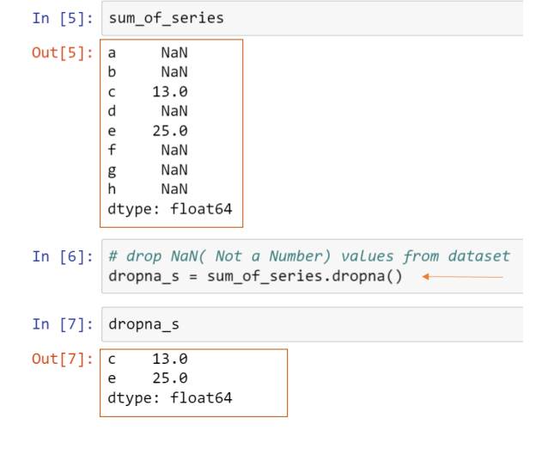
Handling Missing Values using functions
The dropna function drops all the values with uncommon indices.

Slide 27
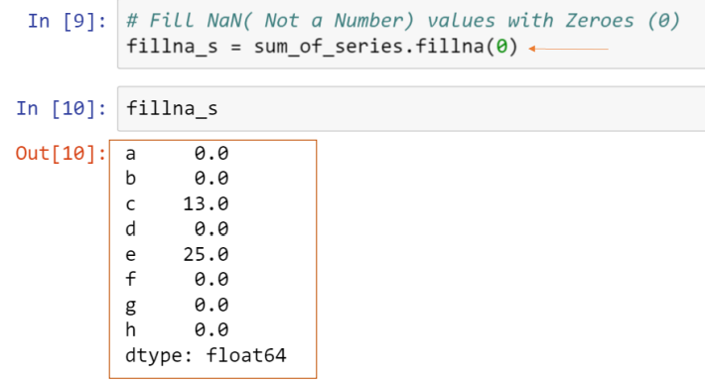
The fillna function fills all the uncommon indices with a number instead of dropping them

Slide 28
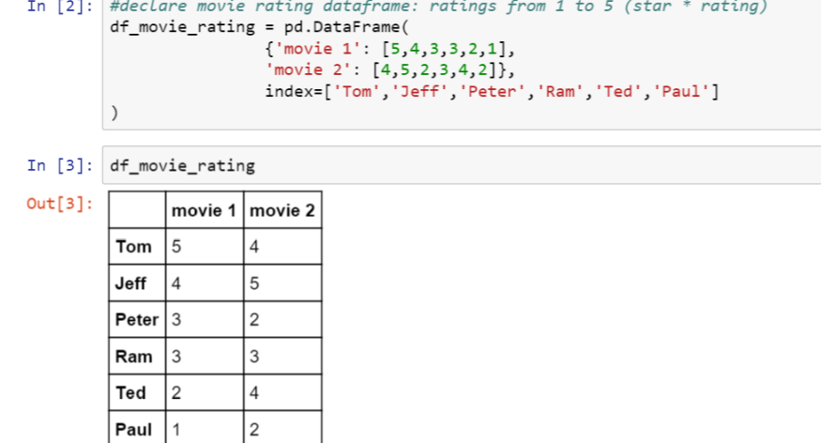
Data Operation
Data operation can be performed through various built-in methods for faster data processing.

Slide 29
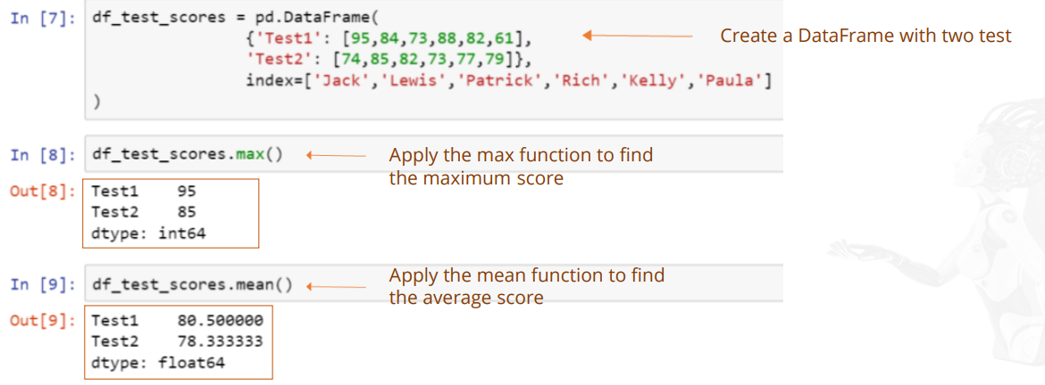
Data Operation with Statistical Functions

Slide 30
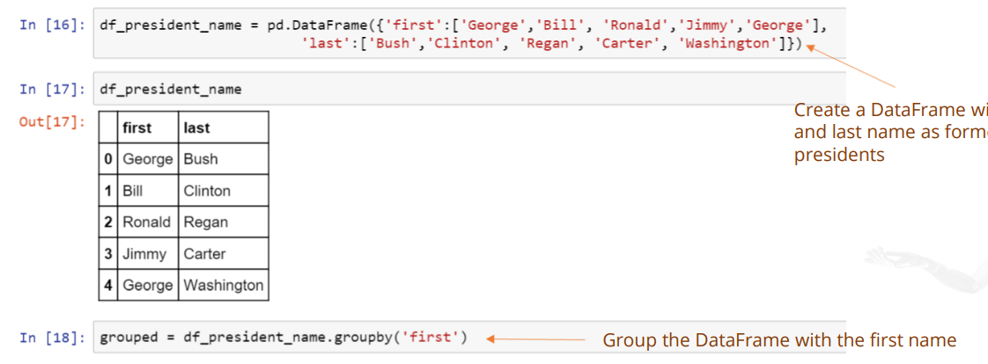
Data Operation Using Groupby

Slide 31
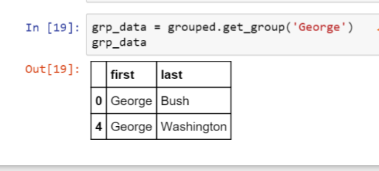

Slide 32
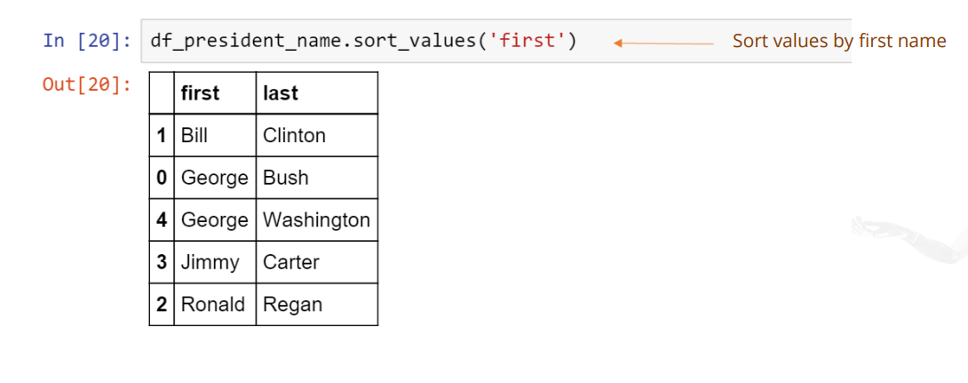
Data Operation Using Sorting

Slide 33
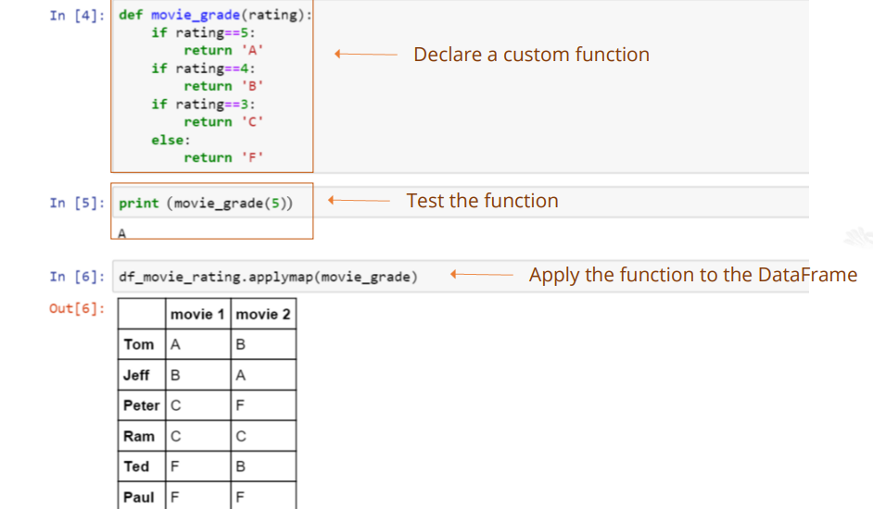
Data Operation with Functions

Slide 34
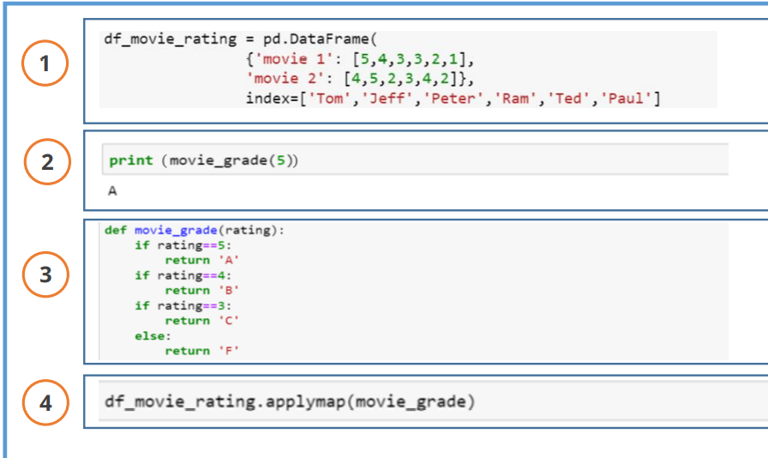
Sequence it Right!

Slide 35
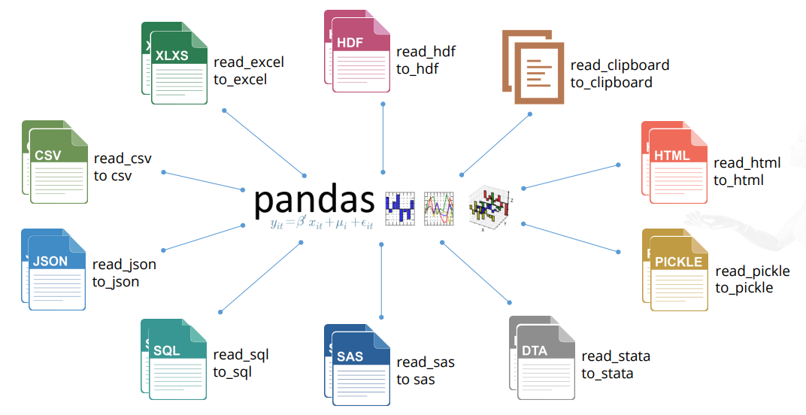
File Read and Write Support

Slide 36
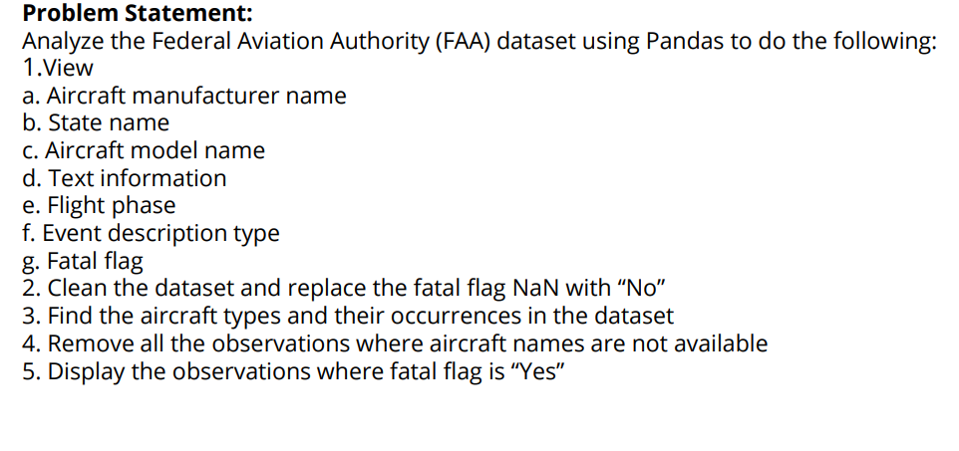
PROJECT 1

Slide 37
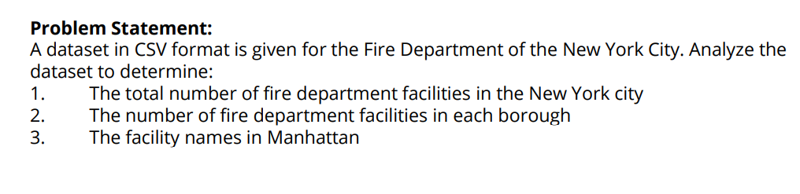
PROJECT 2

